Slide 1
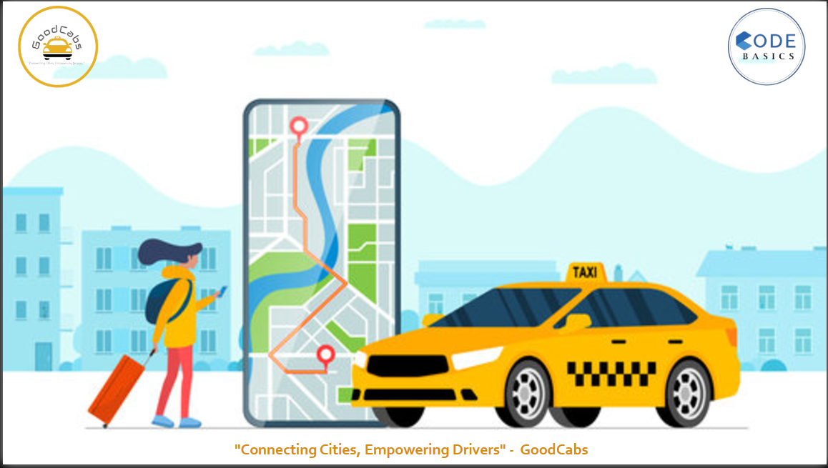

Slide 2

Table Of Content
Company Overview
Problem Statement
Dashboard Preview
Primary & Secondary Research Questions
AD – Hoc Business Requests
Recommendation
Conclusion

Slide 3
GoodCabs : Driving Innovation in Tier-2 Mobility
Company Overview :
Established two years ago, Goodcabs is a leading cab service company focused on tier-2 cities in India.
It supports local drivers, enabling them to sustain livelihoods while ensuring exceptional passenger service.
Operating in 10 tier-2 cities, Goodcabs is rapidly growing and has set ambitious targets for 2024.
Market Focus :
Goodcabs caters to tier-2 cities, offering a unique blend of affordability, accessibility, and driver empowerment.
The company is committed to bridging service gaps in underserved areas and boosting passenger satisfaction
Performance Analysis Goal :
The management aims to evaluate key metrics such as trip volume, repeat passenger rate, and customer satisfaction.
Insights from this analysis will drive strategic growth and improve operational efficiency in the coming year.

Slide 4
Problem Statement
Purpose:
GoodCabs aims to enhance its operational excellence and passenger satisfaction by focusing on key performance indicators such as trip volume, customer retention, and trip distribution.
Problem Statement :
Despite establishing a strong presence in tier-2 cities, Goodcabs faces challenges in achieving its ambitious 2024 targets.
The company needs a detailed analysis of performance metrics, including trip volume, passenger satisfaction, and retention rates, to identify key growth opportunities and address operational inefficiencies.

Slide 5
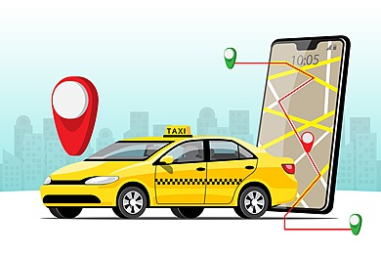

GoodCabs:
India’s Tier - 2 Cities Market Study Dashboard
Presenting By – Harshita Ahra
PowerBI Dashboard View
Domain – Transportation & Mobility

Slide 6
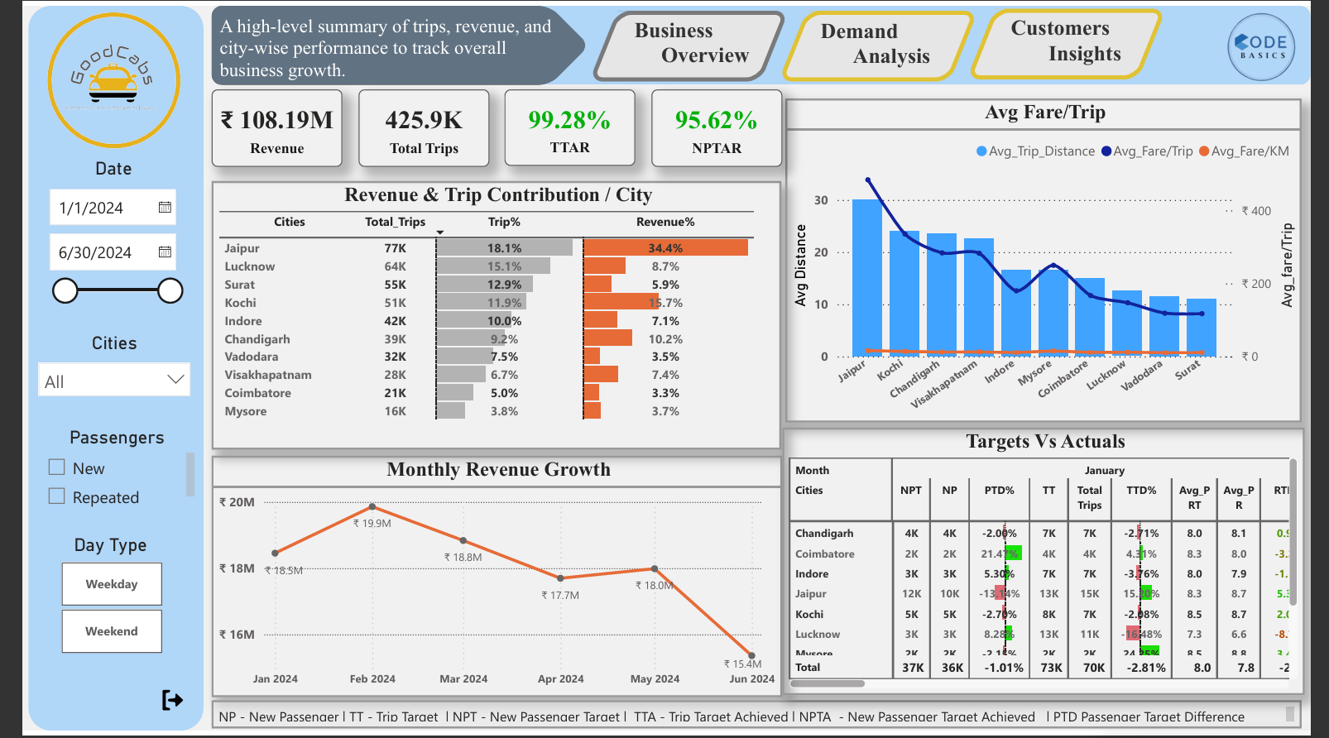

Slide 7
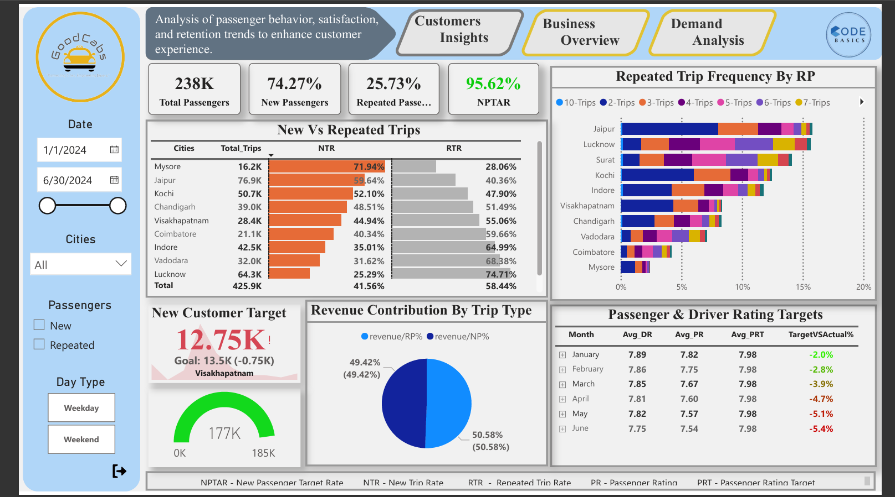

Slide 8
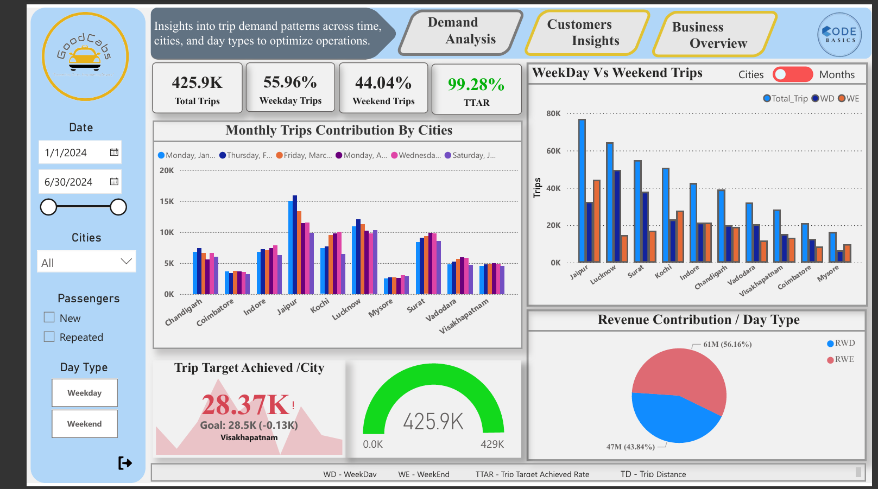

Slide 9
Primary Research Questions

Slide 10
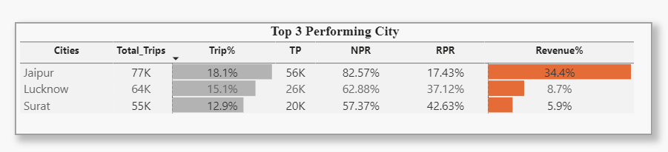
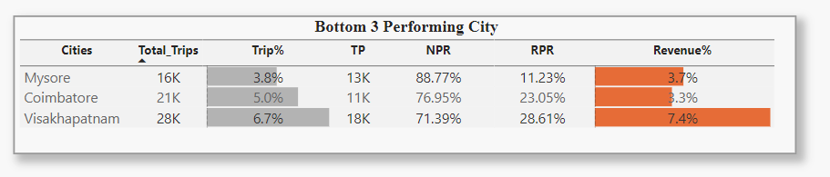
1. Top 3 & Bottom 3 Performing Cities

Slide 11
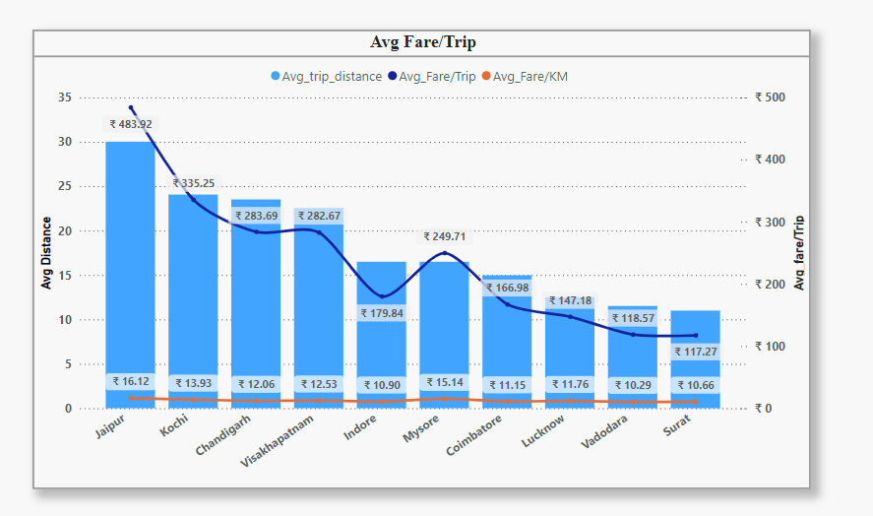
2. Average Fare Per Trip By City

Slide 12
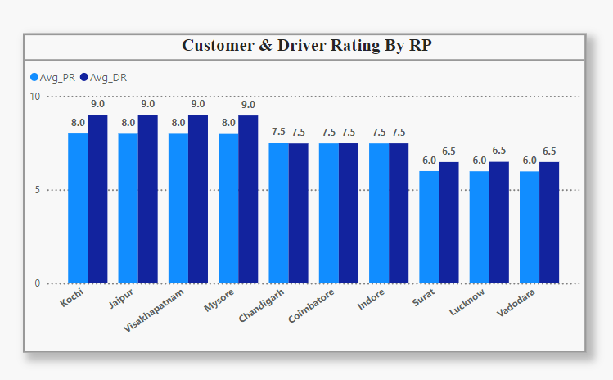
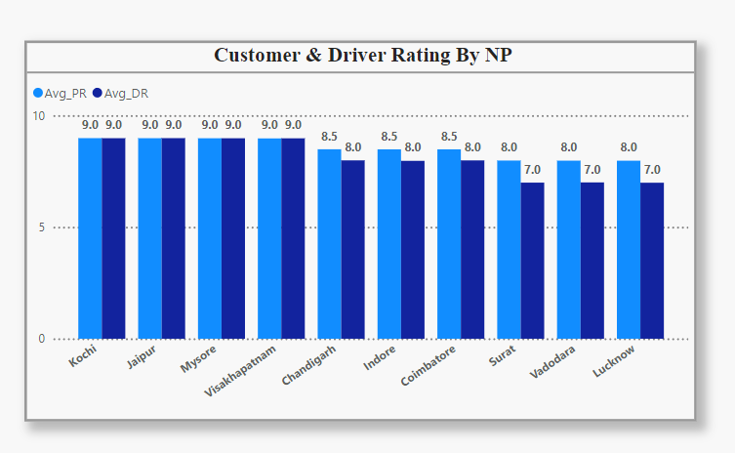
3. Average Rating By Cities & Passenger Types

Slide 13
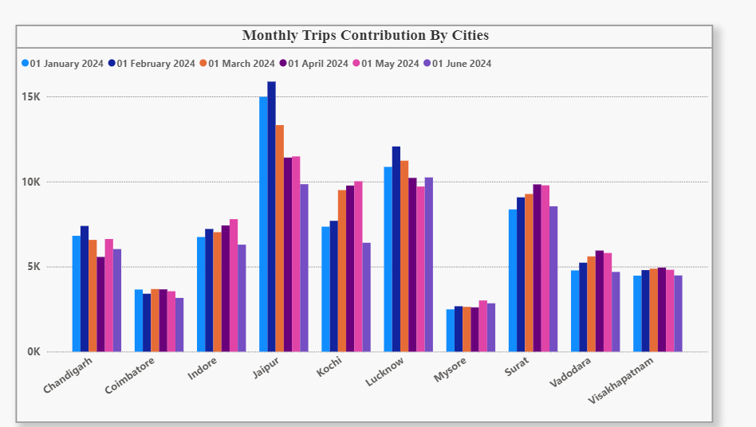
4. Peak & Low Demand Months By City

Slide 14
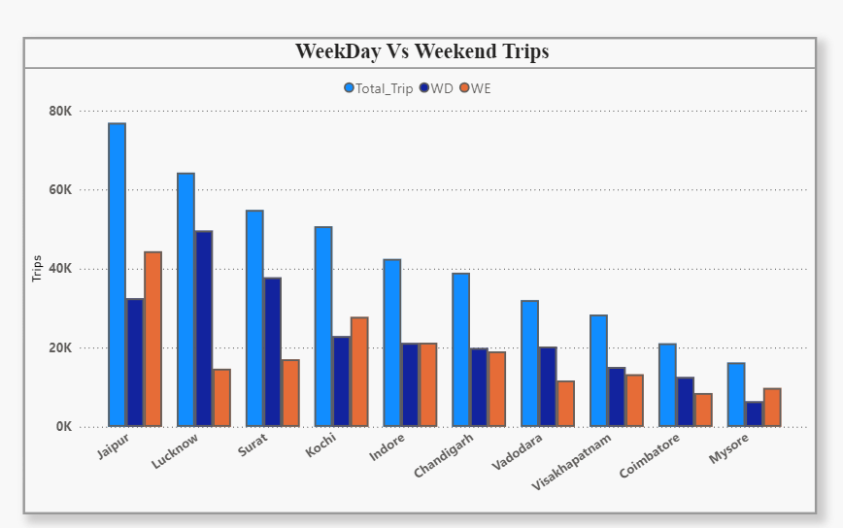
5. Weekend Vs Weekday Trip Demand By Cities

Slide 15
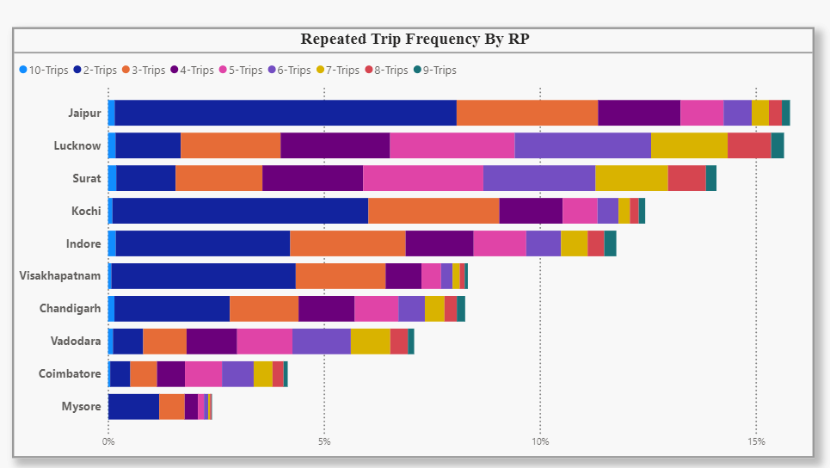
6. Repeat Passenger Frequency & City Contribution Analysis

Slide 16
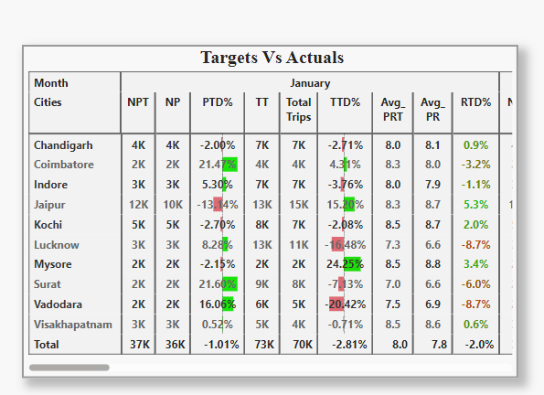
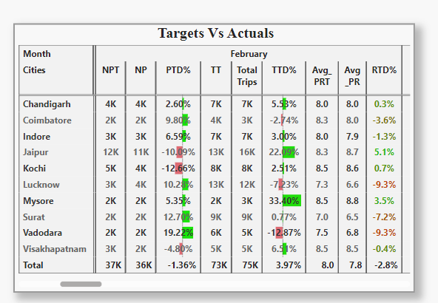
7. Monthly Targets Achievements Analysis For Key Matrix

Slide 17
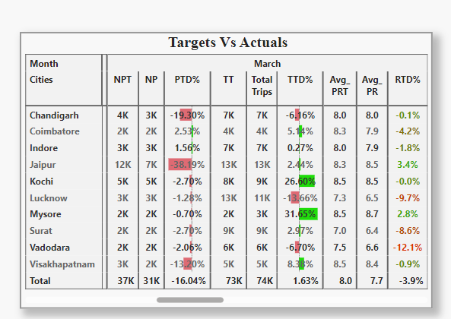
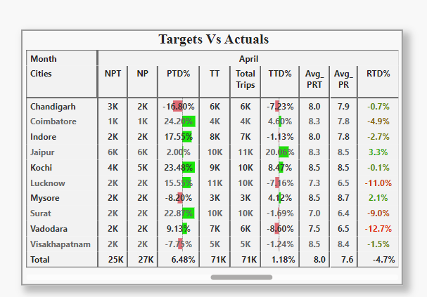
7. Monthly Targets Achievements Analysis For Key Matrix

Slide 18
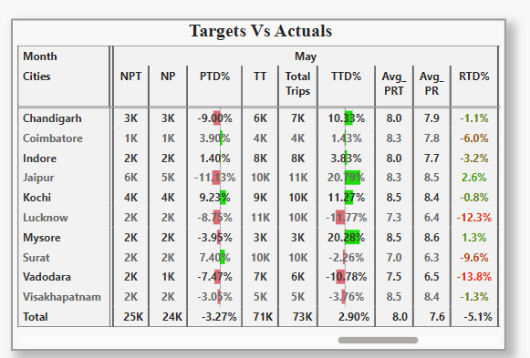
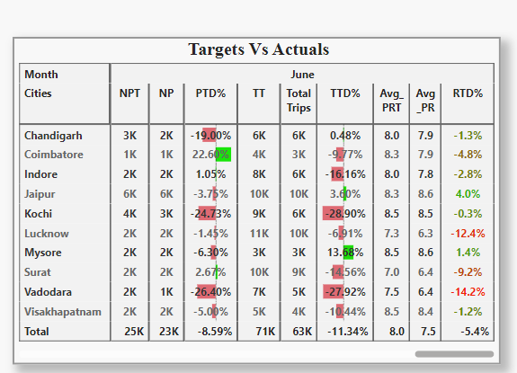
7. Monthly Targets Achievements Analysis For Key Matrix

Slide 19
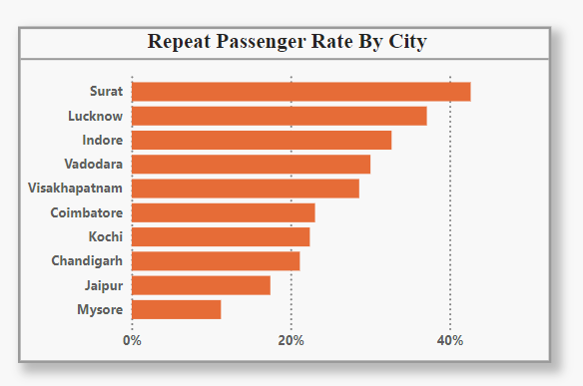
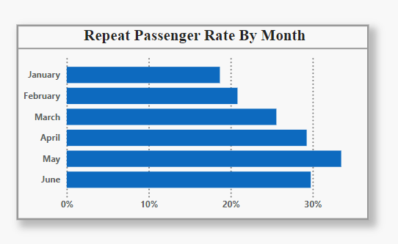
8. Highest & Lowest Repeat Passenger Rate(RPR%) By City and Month

Slide 20
Secondary Research Questions

Slide 21
1. What factors (such as quality of service, competitive pricing, or city demographics) might contribute to higher or lower repeat passenger rates in different cities? Are there correlations with socioeconomic or lifestyle patterns in these cities?
High Repeat Passenger Rate Cities (Surat, Lucknow, Indore):
Affordable Fares:
Surat (₹117), Lucknow (₹147), and Indore (₹179) have low to moderate fares, making them attractive to
budget- conscious passengers.
Moderate Service Quality:
Passenger ratings are 6-7, which indicates decent service but leaves room for improvement
Demographics:
These cities might cater to daily commuters or regular users who prioritize cost over premium service,
driving higher repeat usage.
Low Repeat Passenger Rate Cities (Mysore, Jaipur):
Higher Fares:
Mysore (₹249) and Jaipur (₹483) have significantly higher fares, which may deter repeat passengers, especially
price-sensitive ones.
Tourism-Oriented Demand:
These cities likely attract one-time tourists rather than regular commuters, reducing repeat usage naturally.
High Service Quality:
Despite excellent passenger ratings (9), the higher fares may limit repeat passengers to premium users only.

Slide 22
3. What emerging mobility trends (such as electric vehicle adoption, green energy use) are impacting the cab service market in tier-2 cities? Should Goodcabs consider integrating electric vehicles or eco-friendly initiatives to stay competitive?
Adopt Electric Vehicles: Introduce a small EV fleet in Tier-2 cities with existing EV infrastructure to reduce fuel costs, maintenance expenses, and align with sustainability trends.
Leverage Green Branding: Position GoodCabs as an eco-friendly option to attract environmentally conscious riders by offering "Green Ride" services and promoting carbon savings.
Build Partnerships: Collaborate with EV charging network providers and renewable energy firms to ensure accessible infrastructure and sustainable energy usage.
Enhance Customer Engagement: Develop app features highlighting eco-friendly ride options and incentivize repeat passengers with green ride rewards to boost customer loyalty.

Slide 23
4. Are there opportunities for GoodCabs to partner with local businesses (such as hotels, malls, or event venues) to boost demand and improve customer loyalty? Could these partnerships drive more traffic, especially in tourism- heavy or high-footfall areas?
Goodcabs has significant opportunities to boost demand and loyalty through partnerships. For example, collaborating with 10 high-footfall hotels in cities like Jaipur and Mysore could generate an additional 15,000 rides per month.
Similarly, working with 5 major event venues or malls in each city, especially during events, could add around 5,000 rides monthly per city.
Introducing a loyalty program could increase repeat passenger rates by 20%. For Surat, with a current repeat rate of 40%, this could mean an extra 8,000 rides per month. Lastly, forming tie-ups with corporates, generating 100 rides daily per client, could add around 15,000 rides per month in cities like Lucknow and Indore. These initiatives can drive growth, especially in tourism-heavy and business-centric areas.

Slide 24
4. To make Goodcabs more data-driven and improve its performance across key metrics (such as repeat passenger rate, customer satisfaction, new passengers and trip volume), what additional data should Goodcabs collect? Consider data that could provide deeper insights into customer behaviour, operational efficiency, and market trends.
Customer Behavior Data:
1. Track ride frequency, peak times, and demographics for personalized services.
2. Collect customer feedback and ride duration trends to optimize routes and improve service.
Operational Efficiency Data:
1. Monitor driver performance, maintenance schedules, and fuel/charging efficiency.
2. Track trip completion time, delays, and cab type usage (Premium vs. Light) for better
fleet management.
Market & Financial Data:
1. Set revenue forecasts and track performance for financial alignment.
2. Analyze competitor pricing, local events, and economic indicators to anticipate demand.
Cancellation & Marketing Data:
1. Track cancellation rates and reasons for service improvement.
2. Evaluate marketing strategies and customer acquisition channels to optimize growth.

Slide 25
Ad - Hoc Business Request

Slide 26
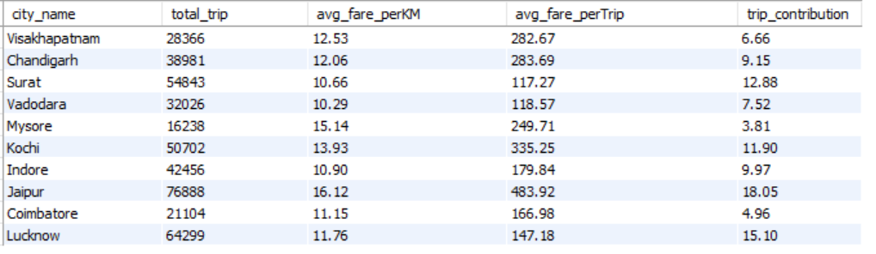
1. City Level Fare & Trip Summary Report

Slide 27
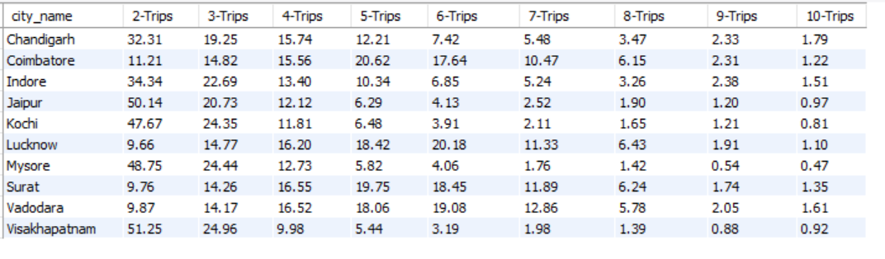
2. City Level Repeated Passenger Trip Frequency Report

Slide 28
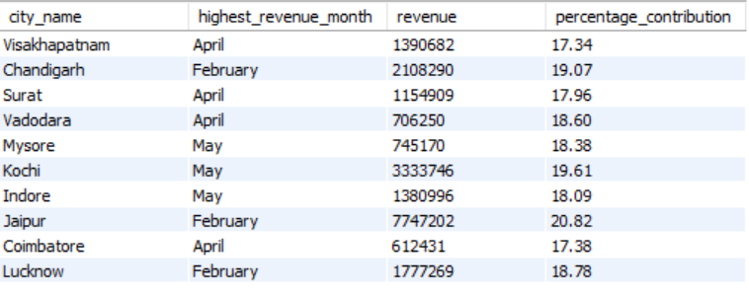
4. Identify the Cities with Highest Revenue Month & % Contribution

Slide 29
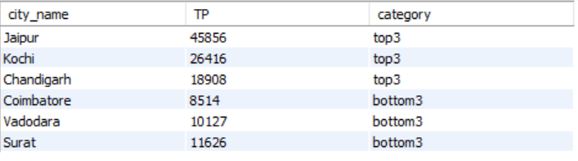
3. Identify the Cities With the Highest & Lowest Total New Passengers

Slide 30
Recommendation
Optimize Pricing Strategies:
Reduce fares in high-potential, low-repeat-rate cities like Mysore and Jaipur to attract budget-conscious repeat passengers.
Implement dynamic pricing during peak demand periods to maximize revenue without deterring frequent riders.
Invest in Sustainability Initiatives:
Introduce electric vehicles (EVs) in cities with existing EV infrastructure to reduce operational costs and enhance green branding.
Promote “Green Ride” options to appeal to environmentally conscious customers and differentiate from competitors.
Strengthen Partnerships:
Collaborate with high-footfall businesses like hotels, malls, and event venues to boost ride demand.
Form corporate tie-ups in business-centric cities like Lucknow and Indore to generate steady demand.
Enhance Customer Engagement:
Launch a loyalty program offering incentives like free rides or discounts to frequent passengers.
Personalize services by leveraging customer behavior data to improve satisfaction and retention.
Focus on Service Quality Improvements:
Enhance driver training programs to consistently deliver high-quality service, particularly in cities with moderate ratings (6–7 range).
Actively collect and act on passenger feedback to refine service offerings.

Slide 31
Conclusion
GoodCabs has demonstrated commendable progress toward its ambitious 2024 goals, achieving 99.29% of the trip target and 95.62% of the passenger target by June. This success underscores the company’s robust operational strategies and its ability to capitalize on the mobility needs of Tier-2 cities.
The strong performance in cities like Surat, Lucknow, and Indore, driven by affordable fares and high repeat passenger rates, has been instrumental in this achievement. However, cities like Mysore and Jaipur, despite higher revenue per trip, require interventions to improve repeat passenger rates, likely impacted by higher fares and reliance on one-time tourist demand.
As GoodCabs approaches its year-end targets, there is room for further improvement. Strategic focus on optimizing pricing, enhancing service quality in moderate-performing cities, and driving passenger retention through loyalty programs will be essential. Additionally, adopting sustainable practices like EV integration and expanding partnerships with local businesses can unlock new growth opportunities and solidify its leadership in the Tier-2 city mobility market.
GoodCabs is well-positioned to exceed its year-end goals while reinforcing its commitment to operational excellence and customer satisfaction.

Slide 32
Thank You

